Slide 1

H&m: Personalized Fashion Recommendations Atoosa rashid

Slide 2

Agenda
Problem Area
Proposed Solution
Exploratory data analysis (EDA)
Challenges
Next Steps

Slide 3

Understanding product performance in retail
Identifying key trends and performance indicators within retail product categories
Enhancing the shopping experience and promoting sustainability through data-driven insights
Leveraging data science to develop robust product recommendations and strategies

Slide 4
Vision for tackling the problem
Proposed Solution:
Analyzing product performance data
Evaluating customer demographic
Developing predictive models to inform product recommendations and inventory management
Expected Impact:
Impact on Retail:
Enhanced customer experience through tailored products
Increased sales and reduced stockouts
Environmental and Economic Impact:
Better inventory management leading to reduced waste
Cost savings and increased operational efficiency

Slide 5
Exploratory data analysis (EDA)

Slide 6
Dataset overview
Three datasets:
Articles_df: Data on the articles of products in the transactions in transactions df by the customers in customer df.
Customers_df: Data on the customers involved in making the transactions found in transactions df and articles of products found in articles df.
Transactions_df: Data on the transactions being made to purchase the articles of products found in the articles df by the customers found in the customers df. Note: The prices are not real prices, they are altered.

Slide 7
Dataset overview
The three dataframes are connected via the transactions df
Transactions_df
customer_df
articles_df

Slide 8

Articles Data frame

Slide 9
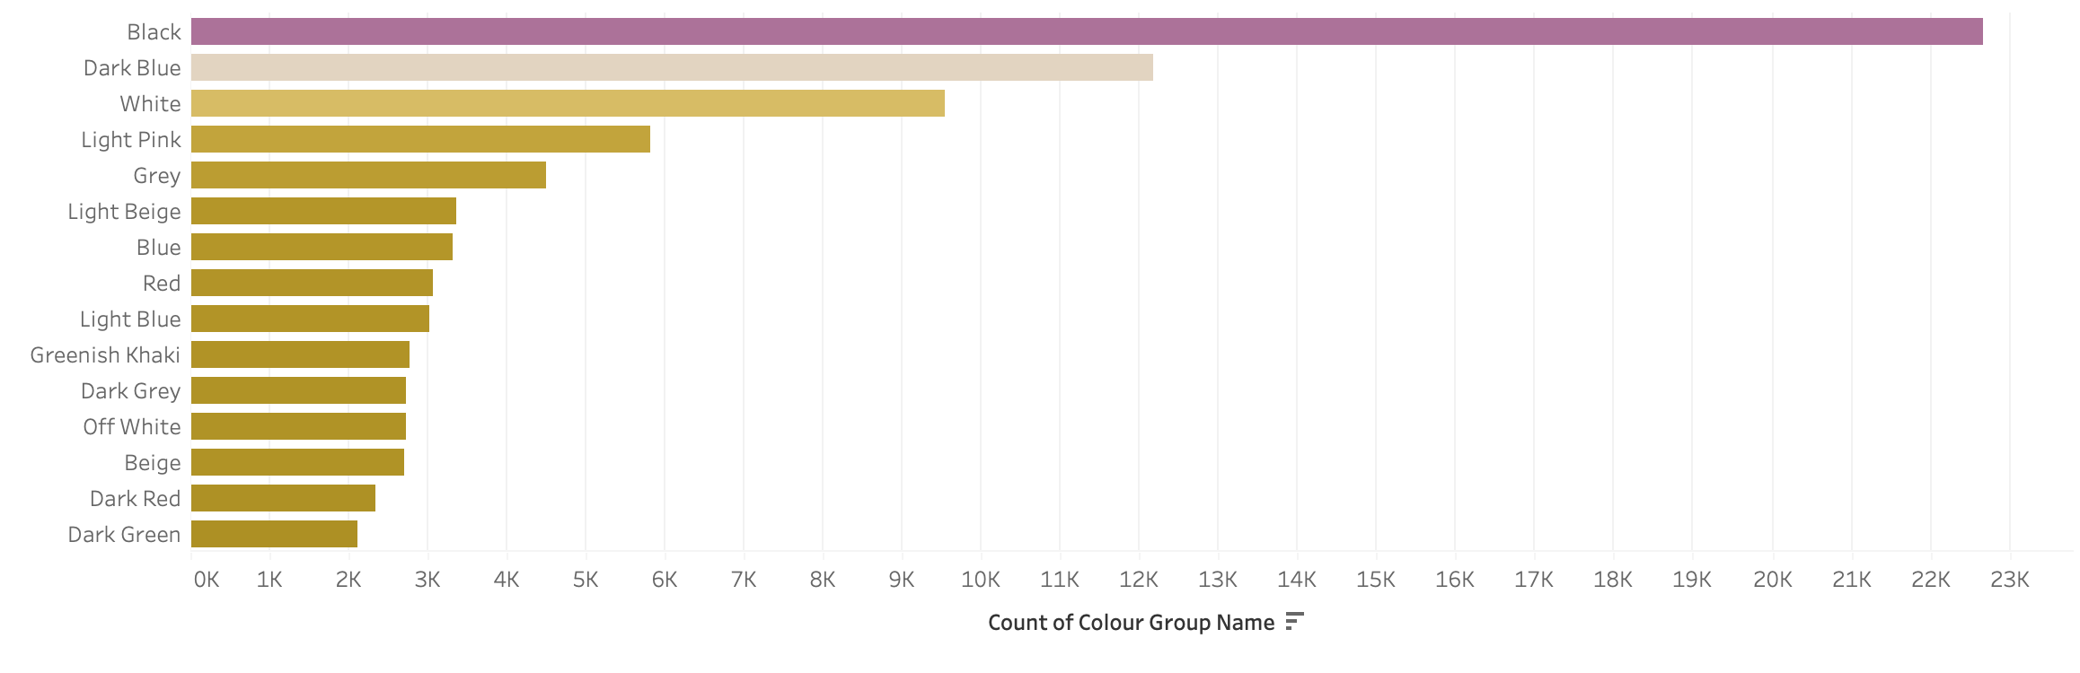
color groups

Slide 10
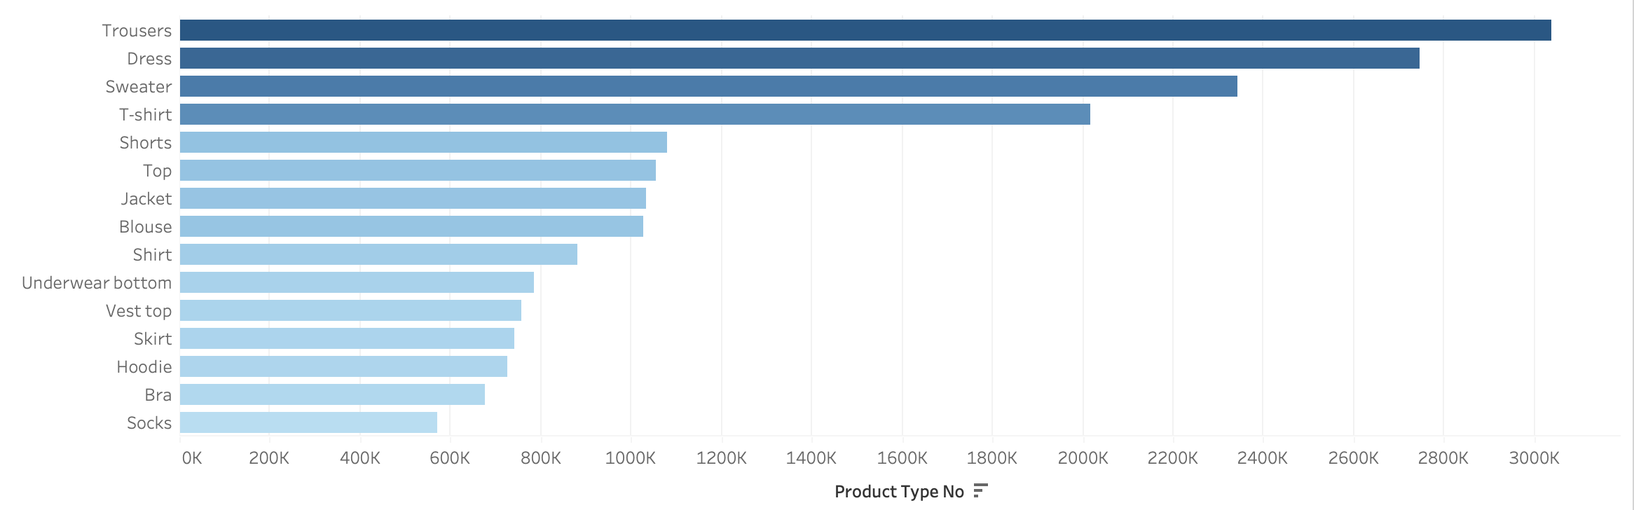
Product types

Slide 11
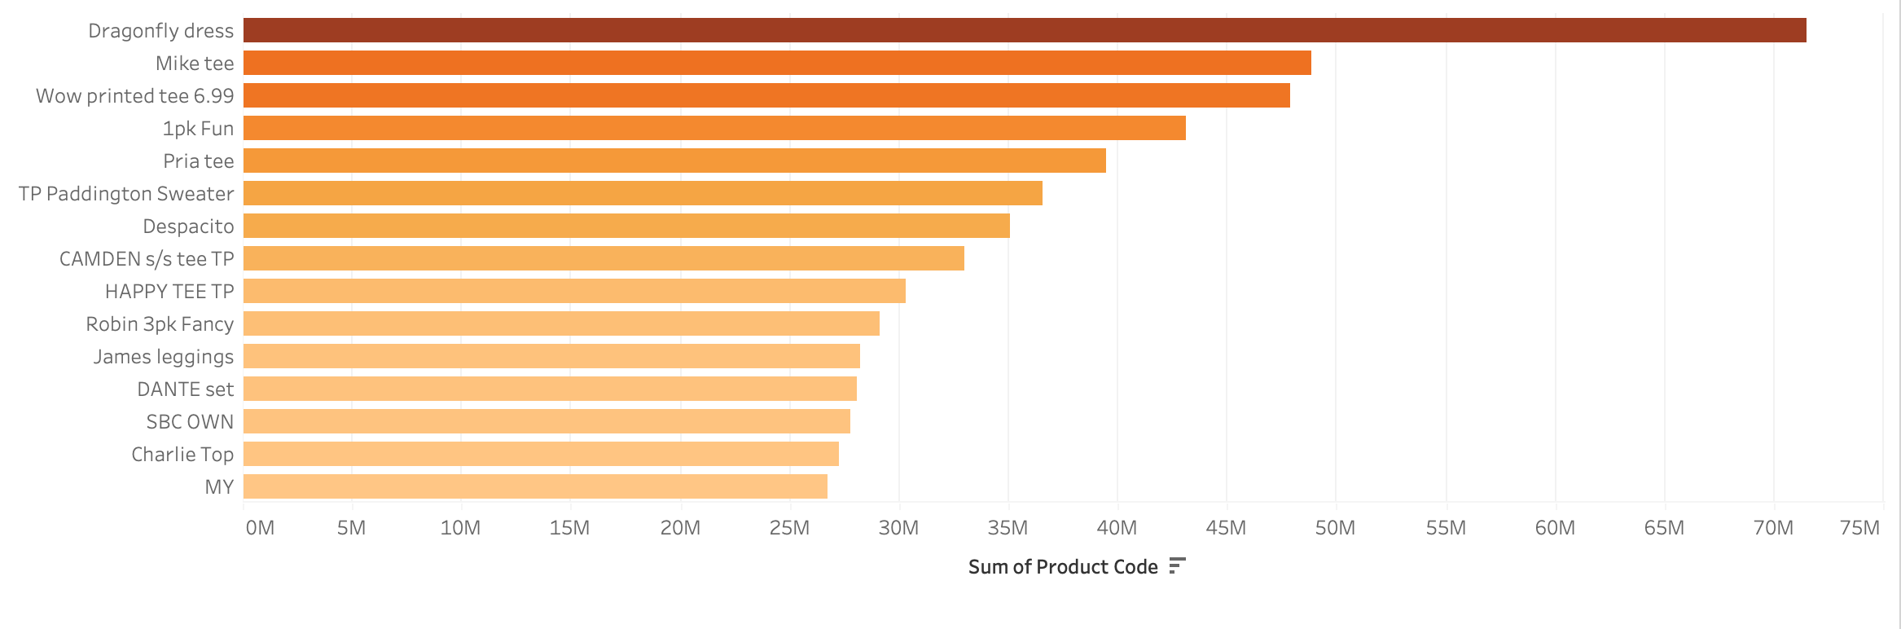
product names

Slide 12
customer Data frame

Slide 13
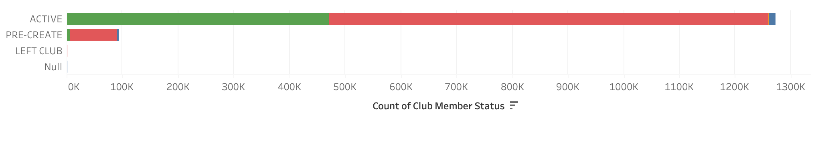
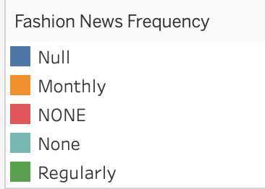
Club membership status and news frequency
Majority of customers are active members of the membership program
Majority of customers do not want to receive fashion news
Important to keep in mind for our recommendation system and methods

Slide 14
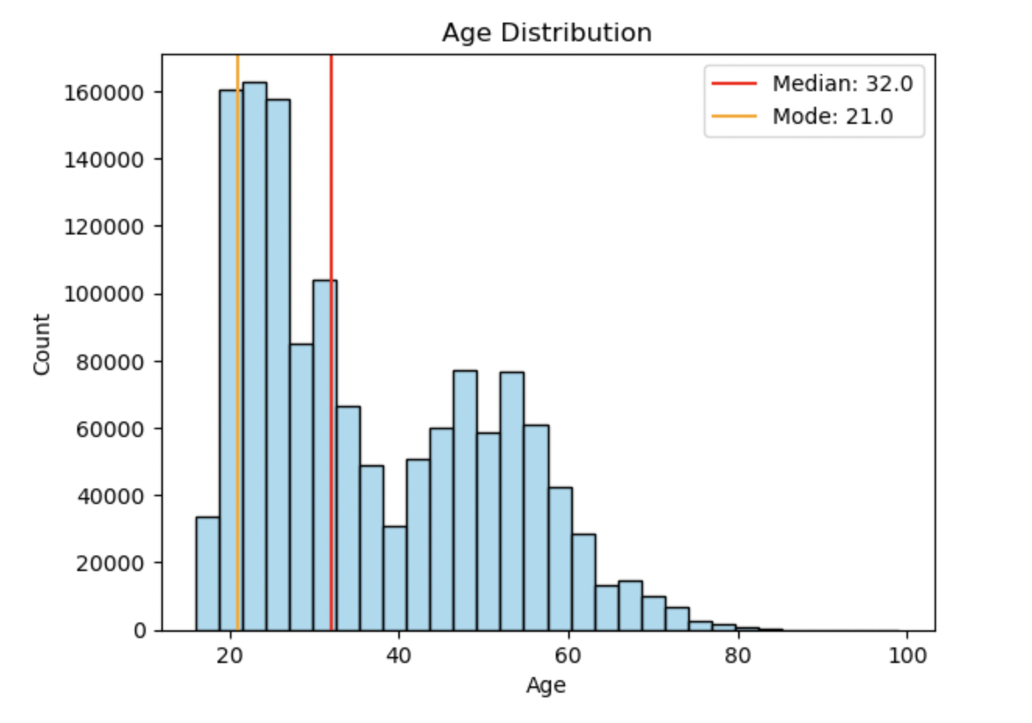
Age distribution
Average age of our customers is 36 years old but the mode is 21 years old
The age distribution is not a normal distribution since it has a right tail
Majority of the customers are below 45, with the peak group being within the range of 20-30 years old

Slide 15
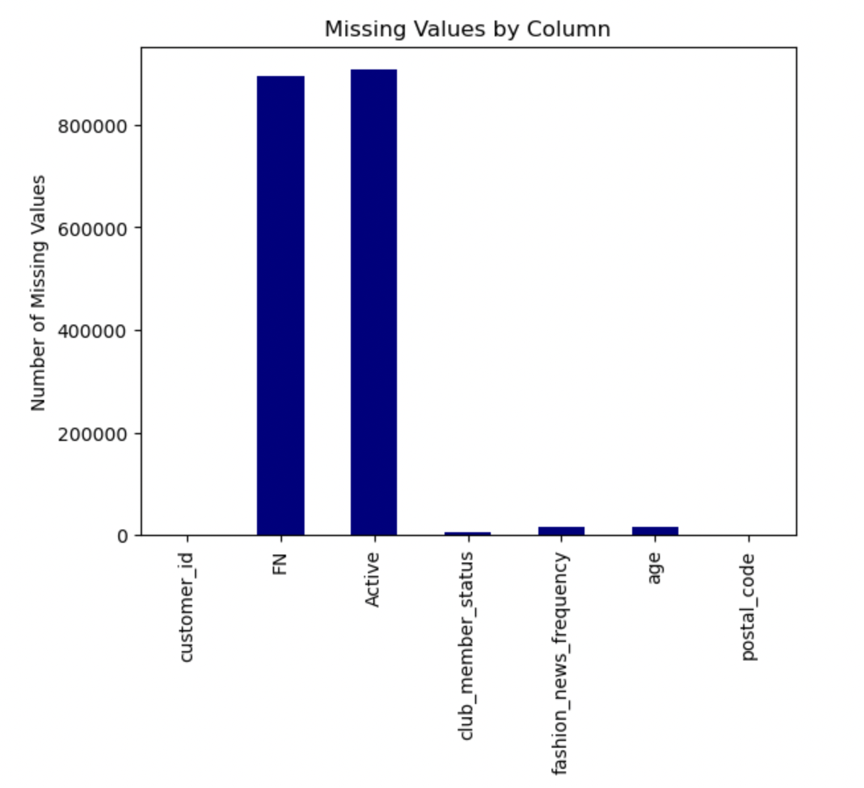
Missing values
Most of the null values are regarding our Active membership and Fashion News

Slide 16
transaction Data frame

Slide 17
Dataset overview
This data set will need to be reduced
The method for reducing the size will depend on our data analysis. A few options include:
Reducing by timeframe: The data set includes data from 2018-09-20 to 2020-09-22, we could reduce it to only one year
Reducing based on price: The data set could be reduced based on the price of the transactions, we could either focus on the lower end or higher end

Slide 18
Going forward
Removing redundant columns, which will be dropped to streamline subsequent processes
Taking care of null-values present, if necessary
Reducing size of transactions_df
Finding and figuring out appropriate modeling and predictive methods

Slide 19
Thank you
(Constructive feedback is appreciated! )

